Slide 1
Basics of Operating System and Shell Scripting
Prepared By: Prof. Kinjal Bhalodiya

Slide 2
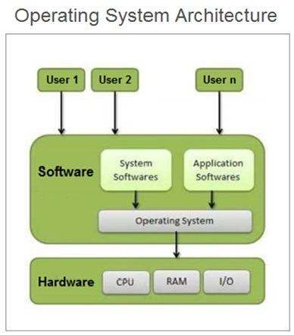
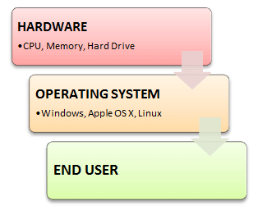
Overview of OS Architecture

Slide 3
What is operating System?
Operating system(OS) is system software that manages computer hardware, software resources & provide common services for computer programs.

Slide 4
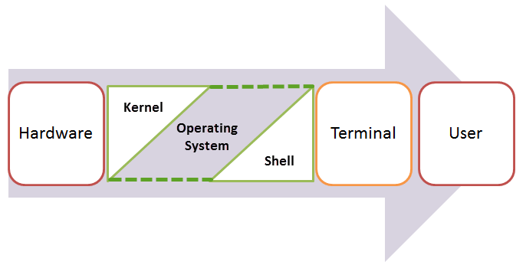
LINUX OS

Slide 5
What is kernel?
The Kernel is a main component of a Linux operating system (OS) and is the core interface between a computer’s hardware and its processes.
The kernel is performing following tasks in LINUX:
Memory management: Keep track of how much memory is used to store what, and where
Process management: Determine which processes can use the central processing unit (CPU), when, and for how long
Device drivers: Act as mediator/interpreter between the hardware and processes
System calls and security: Receive requests for service from the processes

Slide 6
What is Shell?
It gathers input from user and execute the program based on that input. When a program finishes executing, it displays that program's output.
Shell is an environment in which we can run our commands, programs, and shell scripts. There are different flavors of a shell, just as there are different flavors of operating systems.
Each flavor of shell has its own set of recognized commands and functions.

Slide 7
Types of Shell
The Bourne Shell ($):
POSIX shell (sh)
Korn Shell (ksh)
Bourne shell (sh)
Bourne Again SHell (bash)
The C shell (%):
C shell (csh)
Tops C shell (tcsh)

Slide 8
What is Shell Scripting?
It is writing a series of command for the shell to execute.

Slide 9
Why we need to write Shell Scripting?
It can combine lengthy and repetitive sequences of commands into a single and simple script, which can be stored and executed anytime.
This reduces the effort required by the end user.

Slide 10
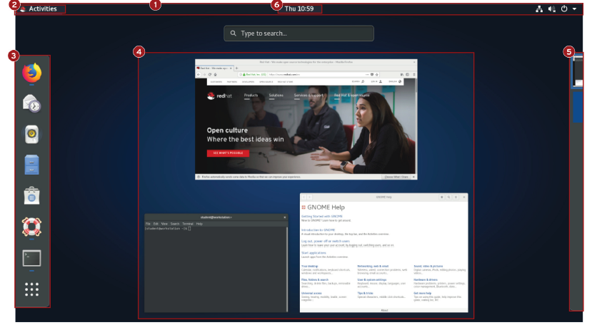
GNOME Shell Overview

Slide 11
GNOME Shell Overview (Cont..)
Top bar: The bar that runs along the top of the screen. It is displayed in the Activities overview and in workspaces.
Activities overview: This is a special mode that helps a user organize windows and start applications.
Dash: This is a configurable list of icons of the user's favorite applications, applications which are currently running, and a grid button at the bottom of the dash which can be used to select arbitrary applications.
Windows overview: An area in the center of the Activities overview which displays thumbnails of all windows active in the current workspace.
Workspace selector: An area to the right of the Activities overview which displays thumbnails of all active workspaces and allows workspaces to be selected and windows to be moved from one workspace to another.
Message tray: The message tray provides a way to review notifications sent by applications or system components to GNOME.

Slide 12
Shell Prompt Overview
Regular user starts a shell, the default prompt ends with a $ character, as shown below.
[user@host ~]$
Super user starts a shell, the default prompt ends with a # character, as shown below.
[root@host ~]#

Slide 13
Shell Basics
Command to run
Options to adjust the behavior of the command
Arguments, which are typically targets to location
Basic Structure:
[Command] [Options] [Arguments]
i.e.
wc –l File

Slide 14
Basic Commands
Whoami-to know current user’s username
Date-to perform date commands in linux
Man commandname-to operate manual of command
touch filename-to create file in bash shell
cat filename-to display content of file on terminal
less filename-to display content of file on terminal
file filename-to get file type
passwd-to change password of current user
head –n filename-to display content from starting of file
tail –n filename-to display content from ending of file
wc filename-to count lines, character & words size of file
History-to show history of previous command
Ls-to list a directory content (files/subdirectories)

